Slide 1
Module #8:
Applications of Number Theory
26年 11月 7日
©2001-2004 Michael P. Frank, revised by S. Kang

Slide 2
Some Misc. Results
Theorem 0 (Euclid):
  ∀a,b > 0: gcd(a,b) = gcd(b, a mod b)
Theorem 1:
  ∀a,b>0: ∃s,t: gcd(a,b) = sa + tb
Lemma 1:
  ∀a,b,c>0: gcd(a,b)=1 ∧ a | bc → a|c
Lemma 2:
  If p is prime and p|a₁a₂…a_{n} (integers a_{i}) then ∃i: p|a_{i}.
Theorem 2:
  If ac ≡ bc (mod m) and gcd(c,m)=1, then a ≡ b (mod m).
26年 11月 7日
©2001-2004 Michael P. Frank, revised by S. Kang

Slide 3
Proof Euclid’s Algorithm Works
Theorem 0: gcd(a,b) = gcd(b,c) if c = a mod b.
Proof: First, c = a mod b implies ∃t: a = bt + c. Let
g = gcd(a,b), and g′ = gcd(b,c). Since g|a and g|b (thus g|bt) we know g|(a−bt), i.e. g|c. Since g|b ∧ g|c, it follows that g ≤ gcd(b,c) = g′.
Now, since g′|b (thus g′|bt) and g′|c, we know g′|(bt+c), i.e., g′|a. Since g′|a ∧ g′|b, it follows that g′ ≤ gcd(a,b) = g.
Since we have shown that both g≤g′ and g′≤g, it must be the case that g=g′. ■
26年 11月 7日
©2001-2004 Michael P. Frank, revised by S. Kang

Slide 4
Proof of Theorem 1
Theorem 1: ∀a≥b≥0 ∃st: gcd(a,b) = sa + tb
Proof: (By induction over the value of the larger argument a.) From theorem 0, we know that gcd(a,b) = gcd(b,c) if
c = a mod b, in which case a = kb + c for some integer k, so c = a − kb. Now, since b<a and c<b, by inductive hypothesis, we can assume that ∃uv: gcd(b,c) = ub + vc. Substituting for c, this is ub+v(a−kb), which we can regroup to get va + (u−vk)b. So now let s = v, and let t = u−vk, and we’re finished. The base case is solved by s=1, t=0, which works for gcd(a,0), or if a=b originally. ■
26年 11月 7日
©2001-2004 Michael P. Frank, revised by S. Kang

Slide 5
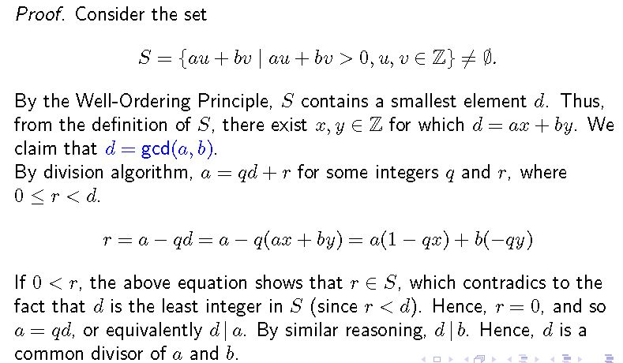
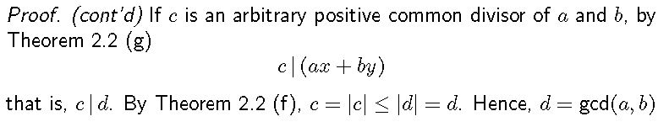
26年 11月 7日
©2001-2004 Michael P. Frank, revised by S. Kang

Slide 6
Proof of Lemma 1
Lemma 1: gcd(a,b)=1 ∧ a|bc → a|c
Proof: Applying theorem 1, ∃st: sa+tb=1. Multiplying through by c, we have that
sac + tbc = c. Since a|bc is given, we know that a|tbc, and obviously a|sac. Thus a|(sac+tbc); in other words, that a|c. ■
26年 11月 7日
©2001-2004 Michael P. Frank, revised by S. Kang

Slide 7
Proof of Lemma 2
Lemma 2: Prime p|a₁…a_{n} → ∃i: p|a_{i}.
Proof: If n=1, this is immediate since p|a₁ → p|a₁. Suppose the lemma is true for all n<k and suppose p|a₁…a_{k}. If p|m where m=a₁…a_{k-1} then we have it inductively. Otherwise, we have p|ma_{k} but ¬(p|m). Since m is not a multiple of p, and p has no factors, m has no common factors with p, thus gcd(m,p)=1. So by applying lemma 1, p|a_{k}. ■
26年 11月 7日
©2001-2004 Michael P. Frank, revised by S. Kang

Slide 8
Uniqueness of Prime Factorizations
“The prime factorization of any number n is unique.”
Theorem: If p₁…p_{s} = q₁…q_{t} are equal products of two nondecreasing sequences of primes, then s=t and p_{i} = q_{i} for all i.
Proof: Assume (without loss of generality) that all primes in common have already been divided out, so that ∀ij: p_{i} ≠ q_{j}. But since p₁…p_{s} = q₁…q_{t}, we have that p₁|q₁…q_{t}, since p₁·(p₂…p_{s}) = q₁…q_{t}. Then applying lemma 2, ∃j: p₁|q_{j}. Since q_{j} is prime, it has no divisors other than itself and 1, so it must be that p_{i}=q_{j}. This contradicts the assumption ∀ij: p_{i} ≠ q_{j}. The only resolution is that after the common primes are divided out, both lists of primes were empty, so we couldn’t pick out p₁. In other words, the two lists must have been identical to begin with! ■
26年 11月 7日
©2001-2004 Michael P. Frank, revised by S. Kang

Slide 9
Proof of Theorem 2
Theorem 2: If ac ≡ bc (mod m) and gcd(c,m)=1, then a ≡ b (mod m).
Proof: Since ac ≡ bc (mod m), this means
m | ac−bc. Factoring the right side, we get m | c(a − b). Since gcd(c,m)=1, lemma 1 implies that m | a−b, in other words, that
a ≡ b (mod m). ■
26年 11月 7日
©2001-2004 Michael P. Frank, revised by S. Kang

Slide 10
Linear Congruences, Inverses
A congruence of the form ax ≡ b (mod m) is called a linear congruence.
  To solve the congruence is to find the x’s that satisfy it.
An inverse of a, modulo m is any integer a′ such that
a′a ≡ 1 (mod m).
  If we can find such an a′, notice that we can then solve ax≡b by multiplying through by it, giving a′ax≡a′b, thus 1·x≡a′b, thus x≡a′b.
Theorem 3: If gcd(a,m)=1 and m>1, then a has a unique (modulo m) inverse a′.
  Proof: By theorem 1, ∃st: sa+tm = 1, so sa+tm ≡ 1 (mod m). Since tm≡0 (mod m), sa≡1 (mod m). Thus s is an inverse of a (mod m). Theorem 2 guarantees that if ra≡sa≡1 then r≡s, thus this inverse is unique mod m. (All inverses of a are in the same congruence class as s.) ■
26年 11月 7日
©2001-2004 Michael P. Frank, revised by S. Kang

Slide 11
Chinese Remainder Theorem
Theorem: (Chinese remainder theorem.) Let m₁,…,m_{n} > 0 be relatively prime. Then the system of congruences x ≡ a_{i} (mod m_{i}) (for i=1 to n) has a unique solution modulo m = m₁·…·m_{n}.
Proof: Let M_{i} = m/m_{i}. (Thus gcd(m_{i}, M_{i})=1.) So by theorem 3, ∃y_{i}=M_{i}′ such that y_{i}M_{i}≡1 (mod m_{i}).
Now let x = ∑_{i} a_{i}y_{i}M_{i}. Since m_{i}|M_{k} for k≠i, M_{k}≡0 (mod m_{i}), so x≡a_{i}y_{i}M_{i}≡a_{i} (mod m_{i}). Thus, the congruences hold. (Uniqueness is an exercise.) □
26年 11月 7日
©2001-2004 Michael P. Frank, revised by S. Kang

Slide 12
Chinese Remainder Theorem
Example. Find a number that leaves the remainders 2, 3, 2 when divided by 3, 5, 7, respectively.
Solution) x ≡ 2 (mod 3), x ≡ 3 (mod 5), x ≡ 2 (mod 7). Note that 3, 5, 7 are relatively primes. Hence, the system has a unique solution modulo 3·5·7 = 105. M₁=35, M₂=21, M₃=15. For congruences, y₁·35 ≡ 1 (mod 3), y₂·21 ≡ 1 (mod 5), y₃·15 ≡ 1 (mod 7), y₁= 2, y₂= 1, y₃= 1 can be a solution. Hence, x = ∑_{i} a_{i}y_{i}M_{i} = 2·35·2 + 3·21·1 + 2·15·1 = 233 is a solution for the system modulo 105. Shortly, x = 233 ≡ 23 (mod 105) is a unique solution.
26年 11月 7日
©2001-2004 Michael P. Frank, revised by S. Kang

Slide 13
Pseudoprimes
Ancient Chinese mathematicians noticed that whenever n (>2) is prime, 2^{n−1}≡1 (mod n).
  Some also claimed that the converse was true.
However, it turns out that the converse is not true!
  If 2^{n−1}≡1 (mod n), it doesn’t follow that n is prime.
    For example, 341=11·31, but 2³⁴⁰≡1 (mod 341).
Composites n with this property are called pseudoprimes.
  More generally, if b^{n−1}≡1 (mod n) and n is composite, then n is called a pseudoprime to the base b.
26年 11月 7日
©2001-2004 Michael P. Frank, revised by S. Kang

Slide 14
Fermat’s Little Theorem
Fermat generalized the ancient observation that 2^{p−1}≡1 (mod p) for primes p to the following more general theorem:
Theorem: (Fermat’s Little Theorem.)
  If p is prime and a is any non-negative integer such that ¬(p|a), then a^{p−1}≡1 (mod p).
Corollary: If p is a prime, a^{p} ≡ a (mod p) for any integer a.
26年 11月 7日
©2001-2004 Michael P. Frank, revised by S. Kang

Slide 15
Fermat’s Little Theorem
Proof (Fermat’s Little Theorem):
Consider p-1 positive multiples of a:
a, 2a, 3a, … , (p-1)a
None of these are congruent (modulo p) to any other or zero. Hence, they must be congruent modulo p to 1, 2, 3, … , p-1, in some order.
Hence, a·2a·3a···(p-1)a ≡ 1·2·3···(p-1) (mod p), whence
a^{p-1}(p-1)! ≡ (p-1)! (mod p).
Since ¬ (p|(p-1)!), p|(a^{p-1}-1). Hence, a^{p-1} ≡ 1 (mod p).
26年 11月 7日
©2001-2004 Michael P. Frank, revised by S. Kang

